Slide 1

KING MONGKUT'S UNIVERSITY OF TECHNOLOGY THONBURI
INTERNSHIP REPORT
CLOSE AND OPEN THE DOOR SYSTEM
USING THE FINGERPRINT SENSOR
The Author team
Tran Anh Kiet
Bui Dang Khac Huu
The Advisor team
Dr. Pasapitch Chujai
Dr. Maetee Kunrugsa
Ms. Kanyuma Jitjumnong
King Mongkut's University of Technology Thonburi

Slide 2
CONTENT
I PROBLEM
II PROBLEM SOLVING
III RESULTS
IV CONCLUSION
King Mongkut's University of Technology Thonburi

Slide 3
I. PROBLEM
1.1 The reason choose project
Security is very important for us nowadays, we can store and preserve important things. If we use a normal lock, it is easy to hack and break the lock. One of the things that can answer that problem is fingerprint security.
Therefore, this research will help individuals to improve security and applicability in the home.
King Mongkut's University of Technology Thonburi

Slide 4
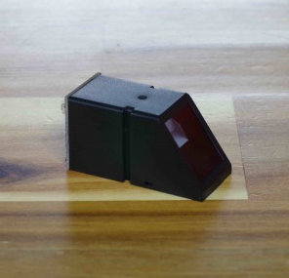
II. PROBLEM SOLVING
2.1 Introduction the Fingerprint sensor module
- Fingerprint sensor modules, like the one in the following figure, made fingerprint recognition more accessible and easy to add to your projects.
- This means that is super easy to make fingerprint collection, registration, comparison and search.
A fingerprint sensor JM-101
King Mongkut's University of Technology Thonburi

Slide 5
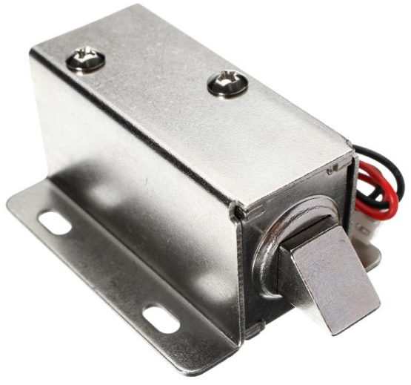
II. PROBLEM SOLVING
2.2 Introduction the Electric Door Lock
Slim design, security, and stability, low power consumption.
Designed with the open frame type and mount board, easy to install.
Suitable for doors, file cabinets, display cabinets, lockers, drawers, etc.
Electric Door Lock
King Mongkut's University of Technology Thonburi

Slide 6
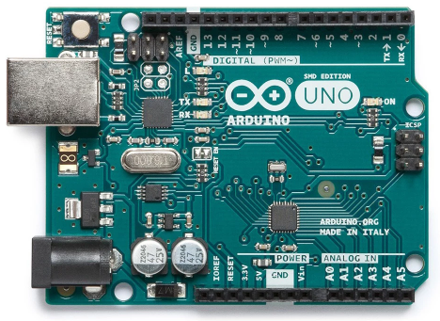
II. PROBLEM SOLVING
2.3 Introduction the Arduino Uno
- Arduino is used for building different types of electronic circuits easily using of both a physical programmable circuit board the usually micro controller and piece of code running on computer with USB connection between the computer and Arduino.
Arduino Uno
King Mongkut's University of Technology Thonburi

Slide 7
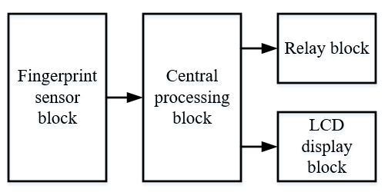
II. PROBLEM SOLVING
2.4 Block diagram
Block diagram of the system
King Mongkut's University of Technology Thonburi

Slide 8
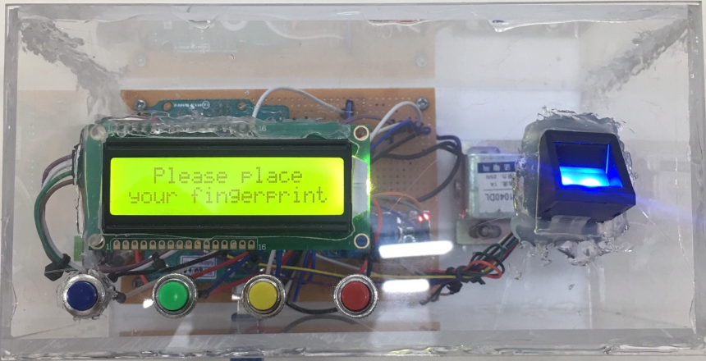
III. RESULTS
3.1 Box design components
Main interface of fingerprint lock
King Mongkut's University of Technology Thonburi

Slide 9
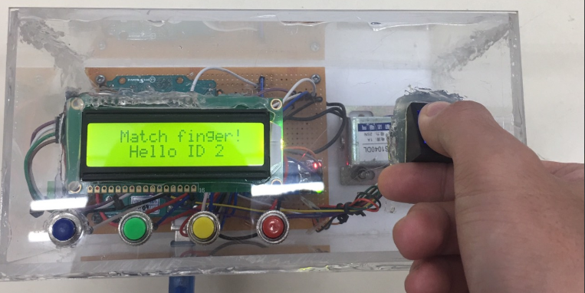
III. RESULTS
3.2 Results
Case 1: Correct fingerprint identification
Correct fingerprint identification
King Mongkut's University of Technology Thonburi

Slide 10
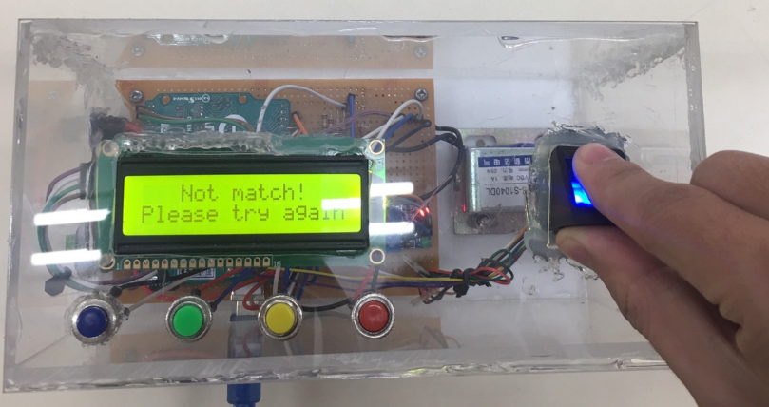
III. RESULTS
Case 2: Wrong fingerprint identification
Incorrect identification of fingerprints
King Mongkut's University of Technology Thonburi

Slide 11
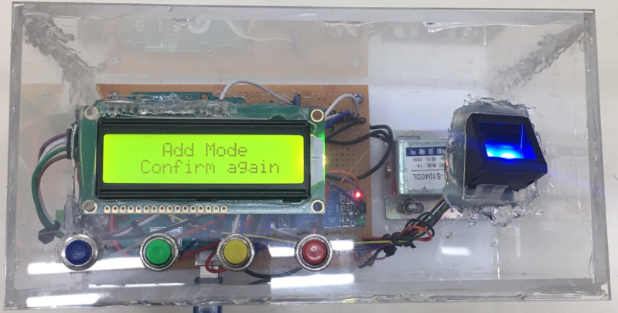
III. RESULTS
Case 3: Add fingerprints
Process of adding a new fingerprint – step 1
King Mongkut's University of Technology Thonburi

Slide 12
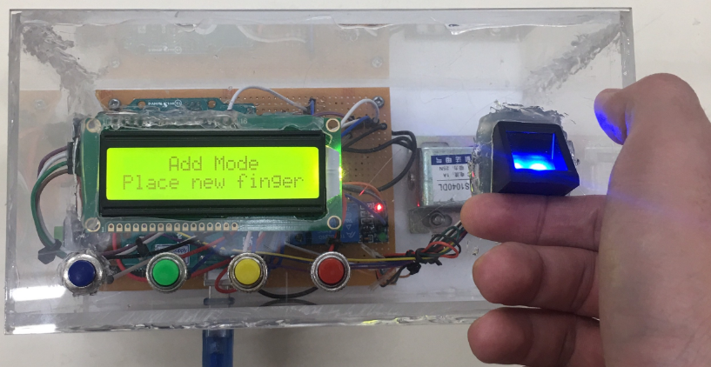
III. RESULTS
Process of adding a new fingerprint – step 2
King Mongkut's University of Technology Thonburi

Slide 13
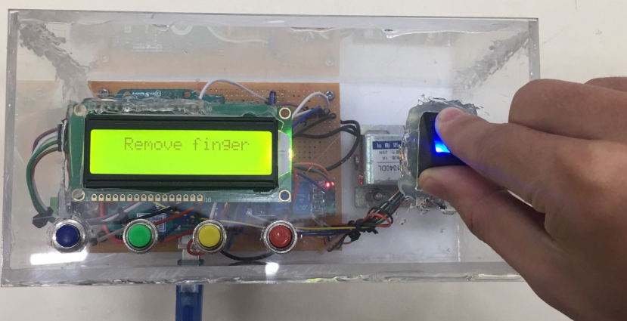
III. RESULTS
Process of adding a new fingerprint – step 3
King Mongkut's University of Technology Thonburi

Slide 14
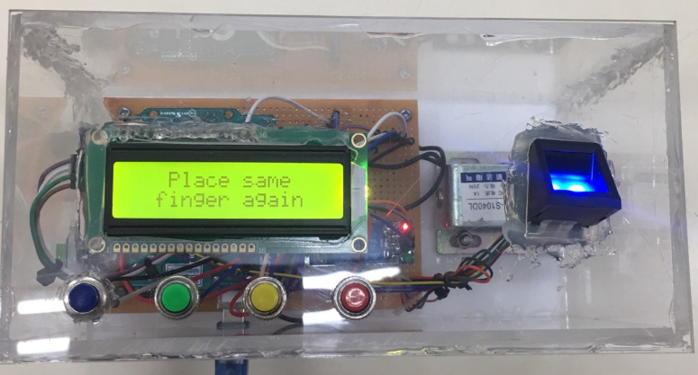
III. RESULTS
Process of adding a new fingerprint – step 4
King Mongkut's University of Technology Thonburi

Slide 15
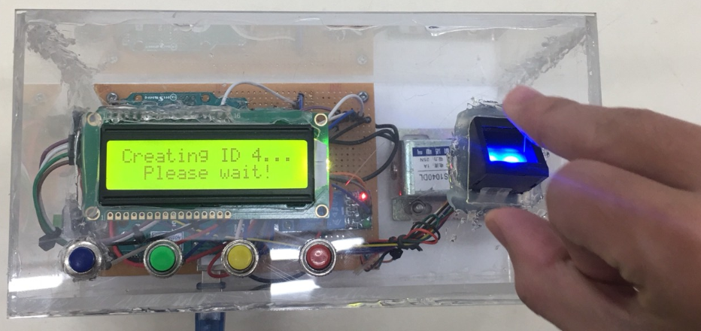
III. RESULTS
Process of adding a new fingerprint – step 5
King Mongkut's University of Technology Thonburi

Slide 16
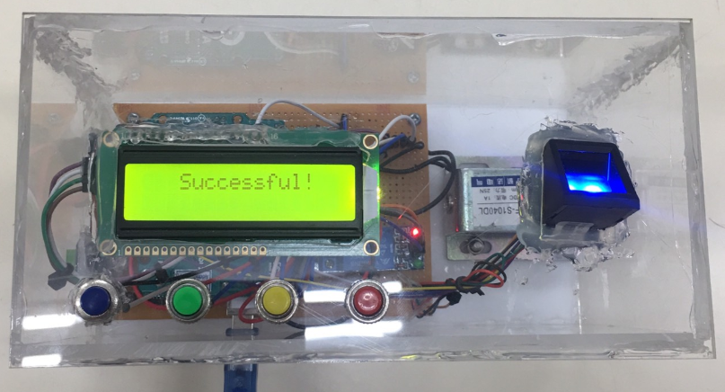
III. RESULTS
Add fingerprint successfully
King Mongkut's University of Technology Thonburi

Slide 17
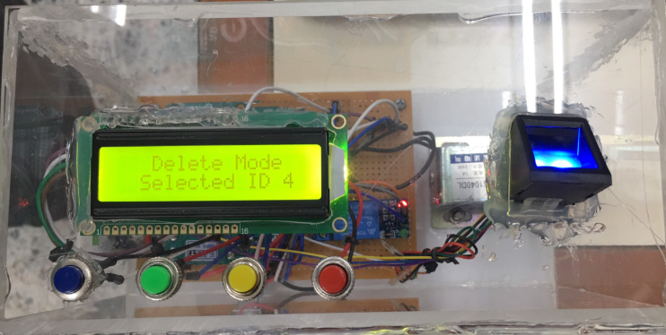
III. RESULTS
Case 4: Delete fingerprints
Process of deleting a fingerprint – step 1
King Mongkut's University of Technology Thonburi

Slide 18
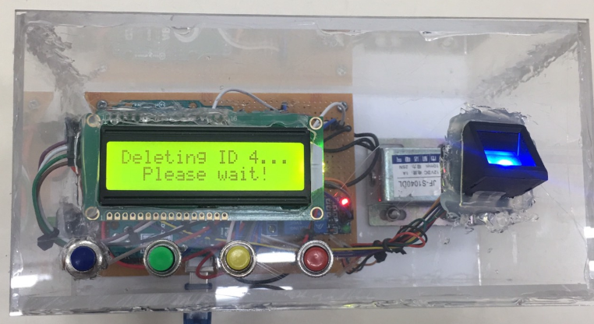
III. RESULTS
Process of deleting a fingerprint – step 2
King Mongkut's University of Technology Thonburi

Slide 19
III. RESULTS
Delete fingerprint successfully
King Mongkut's University of Technology Thonburi

Slide 20
IV. CONCLUSION
Advantages
- Compact circuit size, boxed for easy transport.
- Reasonable price.
- High security.
- Fast fingerprint recognition speed.
Disadvantages
- Box design was not beautiful.
- The sensor is made of plastic so it is easily damaged.
King Mongkut's University of Technology Thonburi

Slide 21

THANKS FOR WATCHING

